Slide 1
AI DeepChat: Knowledge Management and Assessment System
Team12: Zihong Luo, Qiaoyang Bi, Tianyu Zhu, Sijin Wu, Pengyu Lu, Dawei Wang

Slide 2
System Overview
Key Components:
Backend: PHP + MySQL, FastAPI for AI endpoints
Frontend: HTML, CSS, JavaScript with intuitive UI
AI Integration: DeepSeek API for summarization & question generation
Security: Role-based access control, data encryption

Slide 3
Overview of User Interface and Functions
A.Register: Username/Email + password
B.Login and permissions: Username/Email + password, secondary verification code is supported
C.Document management: Multi-format upload (PDF/TXT), Version tracking, fast retrieval
D.AI-driven: Automatic summarization, knowledge extraction, Question bank generation,"Think more" toggle model
E.Conversational interaction: Live chat (WebSocket push), New dialogue/empty dialogue, Historical session search
F.System Settings: API Key and model parameter configuration, One-click interface connectivity testing
G.User actions: Send/regenerate/copy/empty, File drag and drop upload.

Slide 4
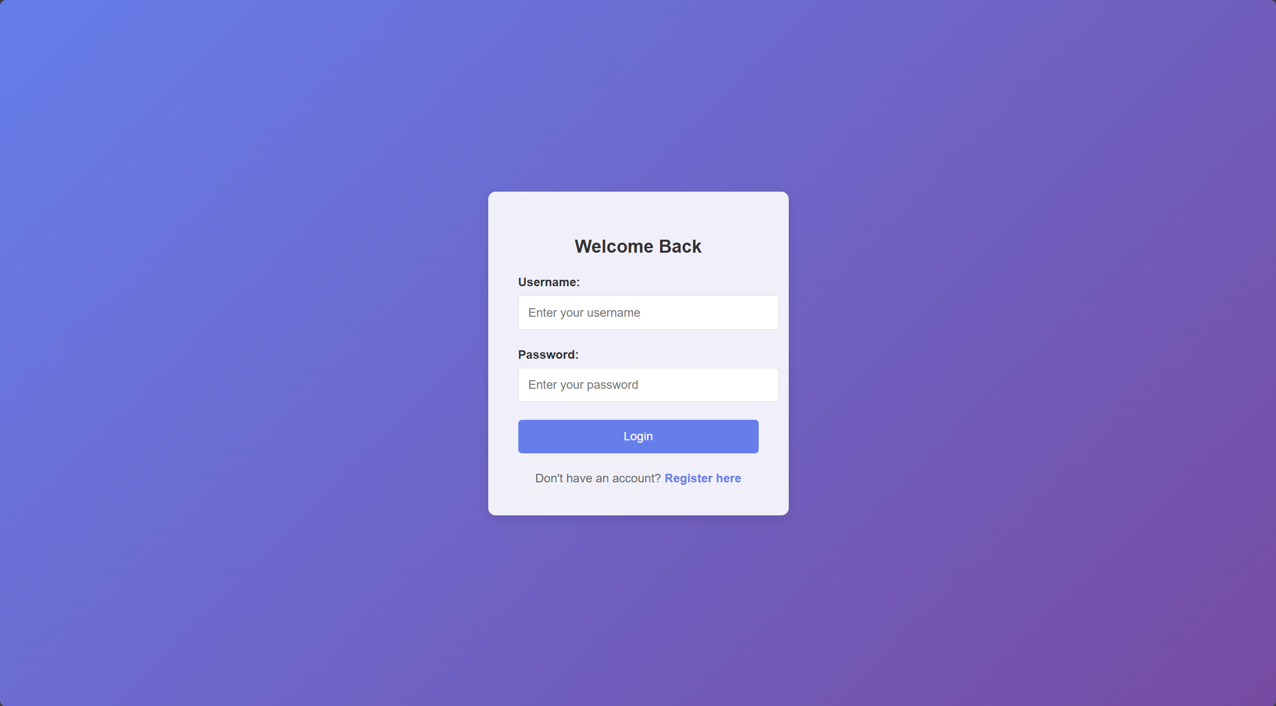
Login screen
Input fields: username/Email, password
Operation buttons: Login, Register here
Security points: password format validation, HTTPS encryption, session timeout

Slide 5
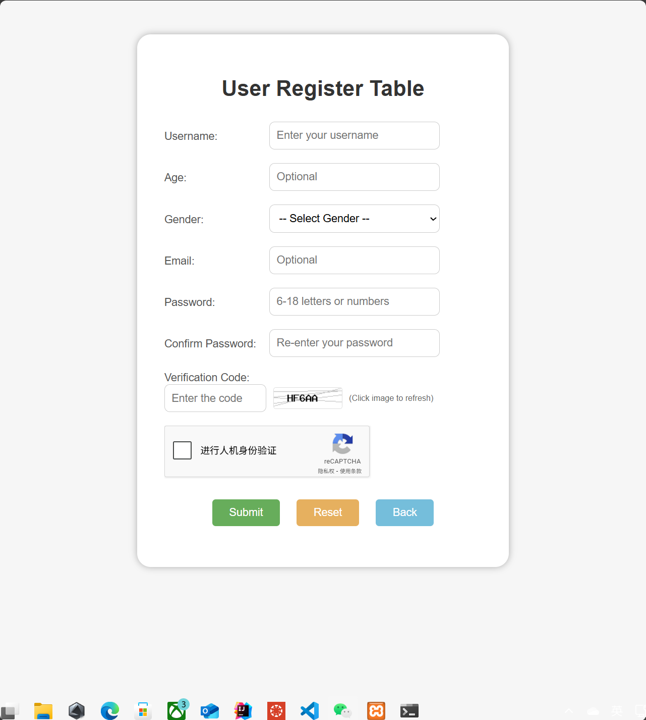
Registration screen
Input fields: username, age, gender, email, password, confirmation password
Action buttons: Submit, Reset, Back
Verification rules: email format, password 6-18 digits, two passwords consistent

Slide 6
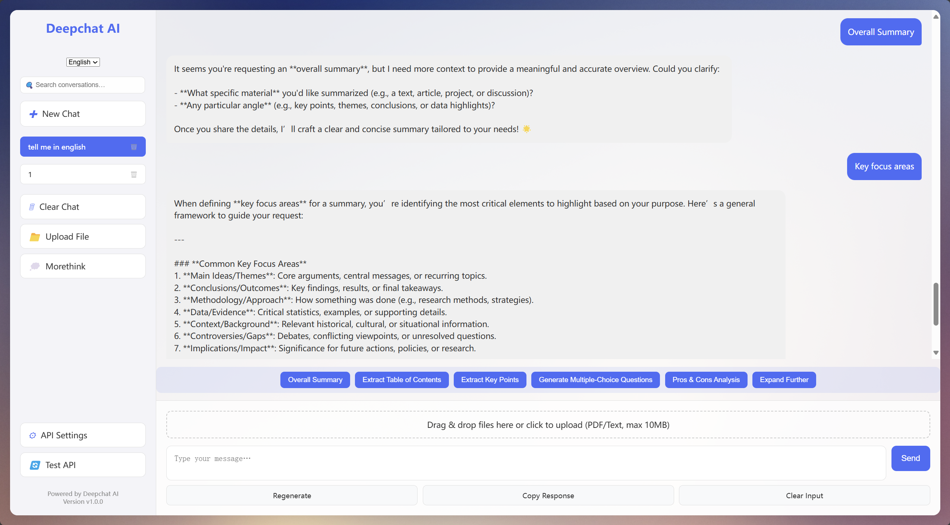
Document Management Features
Uploads & Versioning:
Multi-format support: PDF, TXT
Secure storage and quick retrieval
Version tracking for audit and quality control

Slide 7
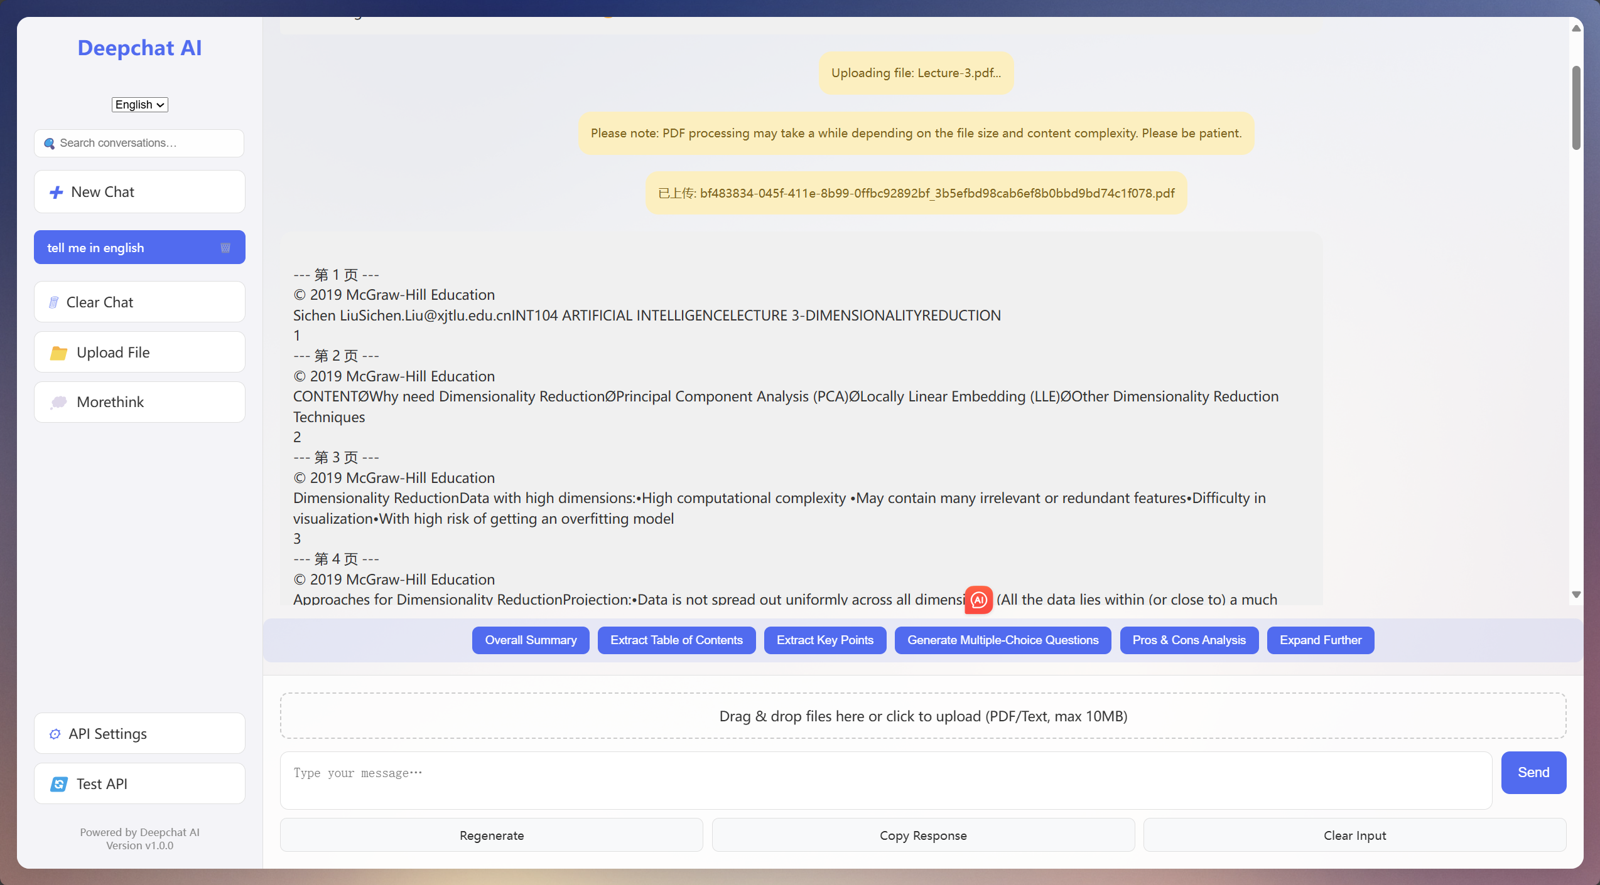
AI-Driven Extraction & Assessment
Automatic summarization: Distill the main points of a document or conversation
Knowledge extraction: Intelligently identify and organize key concepts
Question bank generation: automatic question generation (multiple choice/judgment/fill in the blank)
Deep mode: The "Think More" button triggers a more detailed analysis

Slide 8
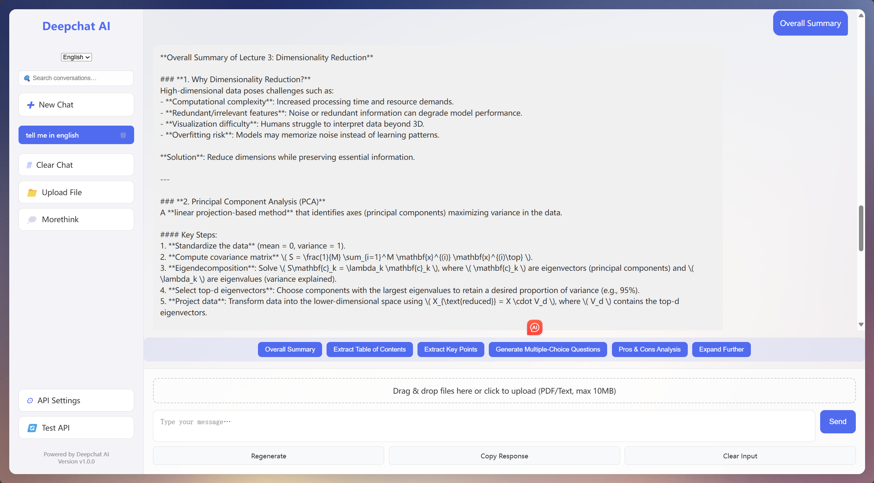
Dialogue interaction
Real-time chat: Based on WebSocket, real-time push AI processing progress and reply
History management: Click "New conversation" to reset the context, click "Clear conversation" only to clear the screen without resetting the session
Conversational search: Quickly locate relevant messages by keyword in the history

Slide 9
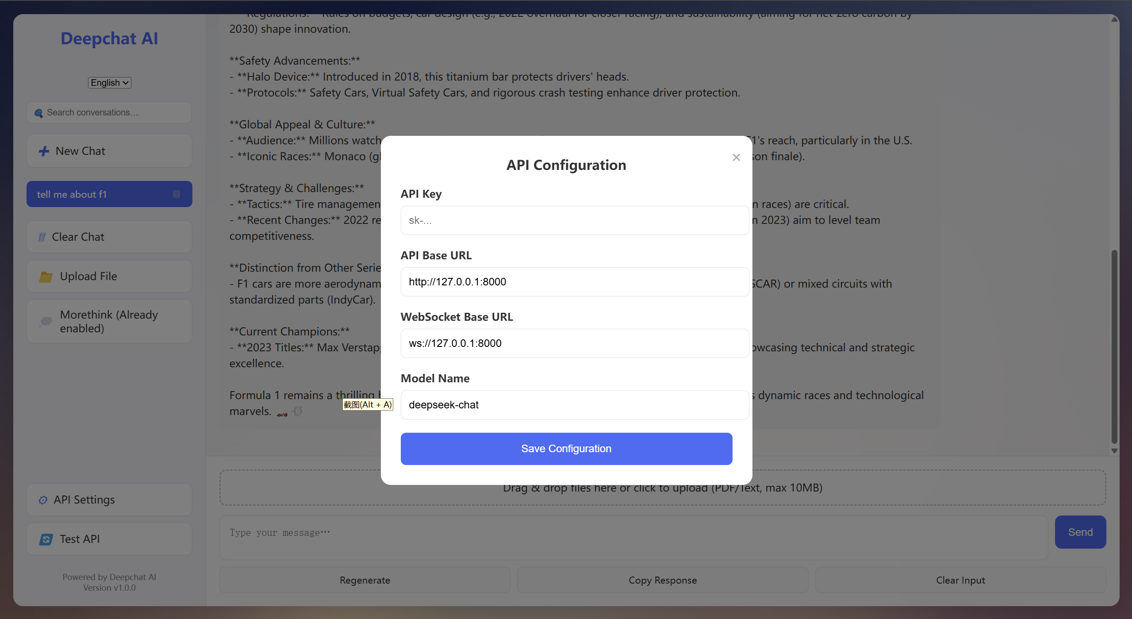
System Settings
API Config: Enter/change API Key, Base URL, model name, temperature, Max Tokens
Interface testing: Ping the backend with one click or sending test messages to quickly verify connectivity and authentication status
Live: Changes are applied immediately without restarting the service

Slide 10
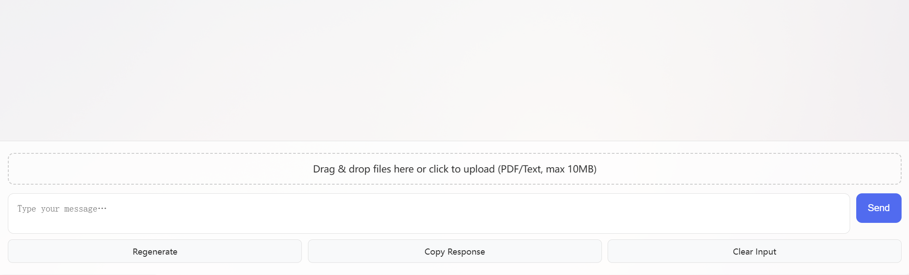
User actions
Send: Click the Send button or Enter to submit the message
Regenerate: reask for the answer to the last question
Copy reply: Copy the latest AI reply to the clipboard with one click
Clear input: Quickly clear the contents of the input field
File upload: Drag or click the uploaded file (Max 10 MB) to trigger AI document processing

Slide 11
Thank You!

